Slide 1
Intro to Judaism
Culture - food

Slide 2
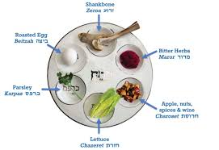
What’s on my tray today?
Every Jewish festival has food linked to it, whether it’s one item or an entire meal. Much of the food is symbolic, so it is present on the table but is not always eaten.
The plate here is used during Passover (which began on Monday).
.

Slide 3
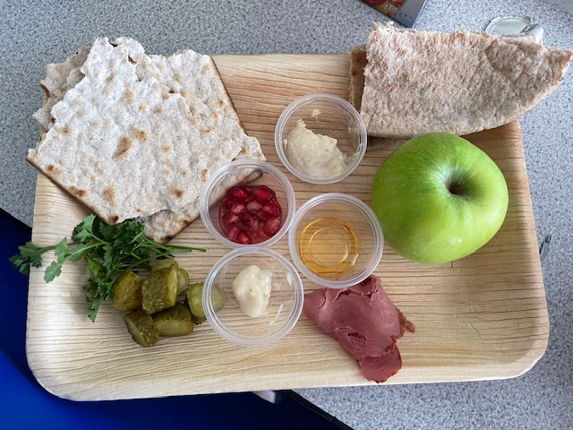
Houmous and flatbread – traditional Middle Eastern cuisine
Pomegranate seeds – represent the 613 Mitzvot (LAWS) of the religion. Used at Rosh Hashanah.
Apple – used in recipe at Passover to make a paste which represents the mortar used in Jewish huts (when living in the desert).
Matzos crackers – represent the unleavened bread made by Jews in the desert (no raising agents)
Honey – used at Rosh Hashanah to represent a positive or ‘sweet’ coming year.
Parsley or pickles – dipped in saltwater to represent the tears of the Jews and their treatment by others.
Beef brisket - Kosher meat – certain meats and certain parts of certain meats are not eaten.
Horseradish – used at Passover to represent the bitterness of Jewish slavery.

