Slide 1

Halloween and Bonfire Night 2023

Slide 2
National Curriculum Objectives
Ways of assessing and reducing risk in relation to health, wellbeing and personal safety

Slide 3
What will be covered in this session?
What is anti-social behaviour?
Hoax calls
How can you protect yourself and others this Halloween?
How can you protect yourself and others this Bonfire Night?
Fireworks and the law

Slide 4
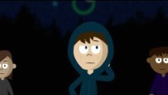
Discussion time!

Slide 5
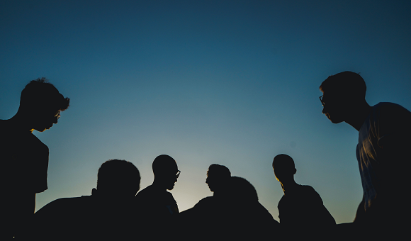
What is Anti-Social Behaviour?
Antisocial behaviour is defined as 'behaviour by a person which causes, or is likely to cause, harassment, alarm or distress
This could be playing tricks on people, upsetting others, throwing eggs, flour or stones and cause damage to property.
Notes:
You can get into a lot of trouble with your parents / guardians and also the POLICE….
THINK about how you behaviour can affect yourself and others.
Antisocial behaviour can be:
Personal, targeting a specific individual or group
Nuisance, when a person causes trouble to a community
Environmental, affecting public spaces or buildings.
What is anti-social behaviour?
Anti-social behaviour includes things such as:
rowdy, noisy behaviour in otherwise quiet neighbourhoods
night time noise from houses or gardens, especially between 11.00 pm and 7.00 am
threatening, drunken or 'yobbish' behaviour
vandalism, graffiti and fly-posting
dealing or buying drugs on the street
litter and fly-tipping rubbish
aggressive begging
drinking in the street
setting off fireworks late at night
abandoning cars on the street
Anti-social behaviour doesn't just make life unpleasant. It can ruin lives and make whole areas feel unsafe.
If you encounter it, report it
If anti-social behaviour is a problem in your area, there’s a lot you can do to help put a stop to it.
You can:
talk to your neighbours to find out if they're affected as well
if you feel comfortable doing so talk to the person causing the problem; they may not realise how it is affecting you
report the problem to your local council's anti-social behaviour coordinator
call your police force's non-emergency number - 101
tell your landlord or residents’ association about the situation
contact your local neighbourhood policing team, or attend one of their regular meetings
If the situation is an emergency (if someone's life or health is threatened) call 999.
No matter how you report anti-social behaviour, all complaints are treated as confidential. So you don’t have to worry about your identity being revealed.
The council and police both need evidence of what's happened to you, so keep a note of problems. They should not ask you to do this indefinitely.
Once you have reported the problem, you should be kept informed of progress in your case.
Source – Direct.gov.uk http://www.direct.gov.uk/en/CrimeJusticeAndTheLaw/CrimePrevention/DG_4001652

Slide 6
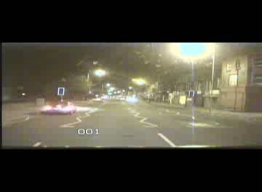


Attacks on Emergency Services and Public Transport Services
Attacks are not allowed at any time.
Some people think its ok to attack Emergency Service Staff. This is dangerous they could hurt and stop them attending a real emergency.
Police and Fire Service vehicles, buses, trains, taxis and public transport stations are fitted with lots of cameras.
PEOPLE WHO THROW ITEMS WILL GET INTO TROUBLE AND THIS COULD RESULT IN A FINE OR EVEN A CRIMINAL RECORD.
Notes:
Video footage shows an Emergency Service Vehicle responding to a call during civil disturbances in Merseyside during August 2011. CCTV was broadcast by Local Media and is in the public domain.
Vehicle received multiple brick and stone attacks and the driver was showered with glass fragments across his face. The emergency call was not attended by the vehicle and the vehicle was not available for 3 hours whilst it was changed for a spare.
Multiple CCTV cameras are fitted to fire appliances, as are multiple cameras on Police vehicles, Ambulances, Buses, Taxis and Trains.
Note : Video only – no sound – speed of video playing is dependant on speed of PC.

Slide 7
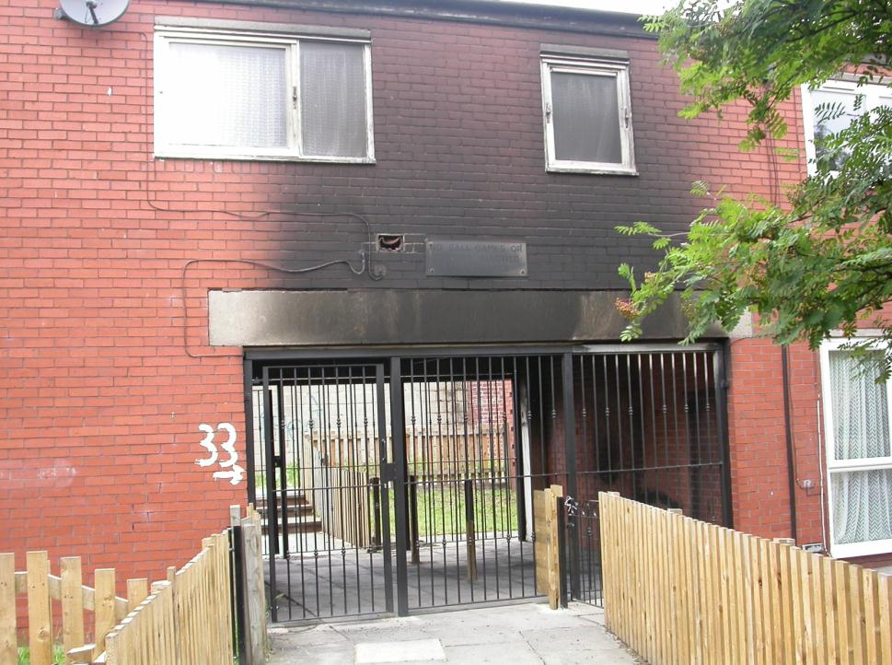
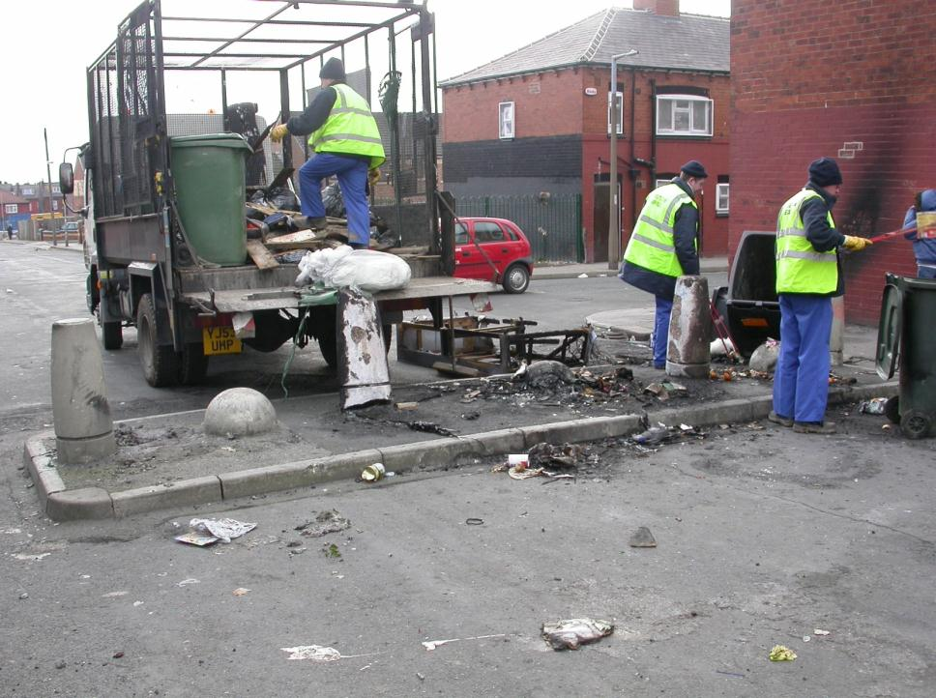
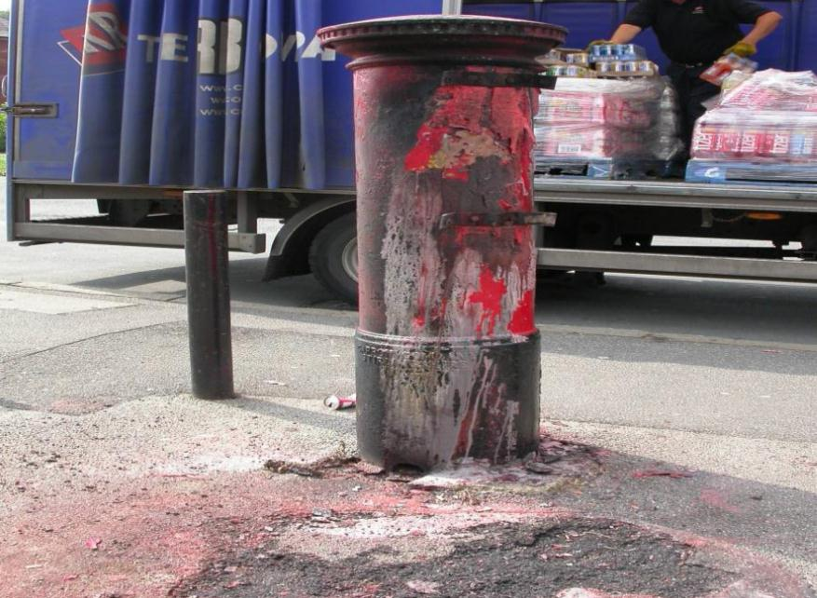
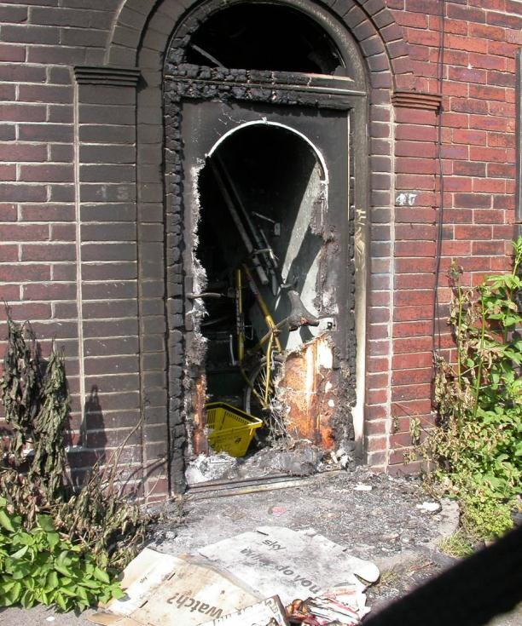
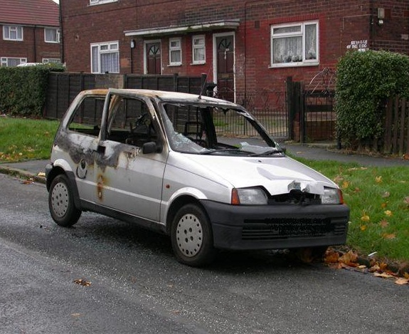
Real life images
How much does this cost the community?
How has normal life been disrupted?
What are the potential consequences?

Slide 8
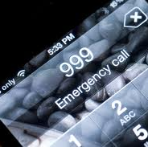
Hoax calls
Do you know the Emergency Services can apply for a mobile phone to be blocked from working if a hoax call has been made from it?
All hoax calls are recorded, logged and traced to find the owner.
Hoax calls to the Emergency Services can result in a fine of up to £5000 (that is 56 iPads) and you can also receive a criminal record which will effect your future.
Notes:
Consequences for the hoaxer
All calls to 999 are voice recorded and it is very easy for the telephone operator to trace the telephone that the hoaxer has called from and, in turn, the address that they have called from. This makes it fairly easy to detect hoax callers.
Criminal proceedings can be brought against any person making a hoax call to the emergency services and they can be taken to court. If they are found guilty of the offence and successfully prosecuted, they may face heavy fines, imprisonment and a criminal record. However, depending on the seriousness, frequency and nature of the hoax calls, some offenders may just get a warning.
It is important that parents or guardians educate children as to the consequences of hoax 999 calls, as children may commit an offence of this nature as part of a practical joke. However, they should be aware that this may be endangering other people’s lives and it may be necessary to divert their time towards more constructive activities.
It is important to remember that 999 should only be used in an emergency requiring the attendance of the police, ambulance or fire services. For all non-emergency policing matters, you should dial 101 or contact your local police force.
Source -http://www.findlaw.co.uk/law/criminal/crimes_a_z/500552.html

Slide 9

Halloween
If you do decide to go trick or treating, please respect the wishes of householders who do not wish to take part
Stay together as a group & tell your parent/guardian where you are going
Stay in well-lit areas
Look out for 'no callers please' posters and respect your neighbours
Respect people’s choice to open or not open the door
Ensure that any ‘tricks’ do not damage people’s property
Notes:
Funded activities will be listed on the Merseyside Police and Crime Commissioner website

Slide 10
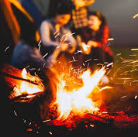
Bonfire night
Stand well back
Never go back to a lit firework
Never put fireworks in your pocket
Never throw fireworks
Light sparklers one at a time and always wear gloves
Never give sparklers to a child under 5
Keep pets indoors
Notes:
Building a bonfire –A job for adults only
Fire can spread easily, so where and how you build your bonfire is important. If you have a bonfire, follow these simple guidelines:
warn your neighbours beforehand - they are much less likely to complain
light the bonfire at a time least likely to affect your neighbours - e.g. not on a warm day when people will be in their garden
only burn dry material not damp, which causes more smoke
build the bonfire away from sheds, fences and trees
check there are no cables - like telephone wires - above the bonfire
don’t use petrol or paraffin to get the fire going – it may get out of control quickly
Bonfire safety tips
Once the bonfire is lit, make sure you:
keep a bucket of water or a garden hose nearby - in case of emergencies
don’t leave the bonfire unattended
keep children and pets away from the bonfire
don’t throw any fireworks into the fire
don't burn aerosols, tyres, canisters or anything containing foam or paint - many produce toxic fumes and some containers may explode, causing injury
Once the bonfire has died down, spray the embers with water to stop it reigniting.
Source – Direct.gov.uk http://www.direct.gov.uk/en/HomeAndCommunity/InYourHome/Escapingandrecoveringfromafire/DG_180786

Slide 11

Fireworks and the law
It is an offence
for anyone under 18 to purchase fireworks
for anyone under 18 to possess fireworks in a public place.
for anyone to let fireworks off during night hours (11pm to 7am)
or set off fireworks in any highway, street, thoroughfare or public place
Notes:
Only adults - over 18’s are allowed to buy and light
fireworks.
Fireworks are for private use – They must never be
set off in a public place; a street, bus, train, park, or near other persons or animals.
Bangers are illegal - Anybody found selling them, buying them or
having them will get in trouble with the police.
Shops which have been checked are then given permission to sell fireworks to adults only.

Slide 12
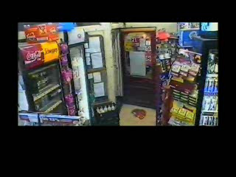
Notes:
Play video (Starts automatically)
A youth in a Halloween mask throws an industrial firework into an off license in Bolton
The firework was made up of 200 rockets
The shopkeeper managed to kick the fire works out of the shop
Discuss the possible consequences
The shopkeeper’s baby was behind the counter and suffered injuries sustained by smoke inhalation

Slide 13
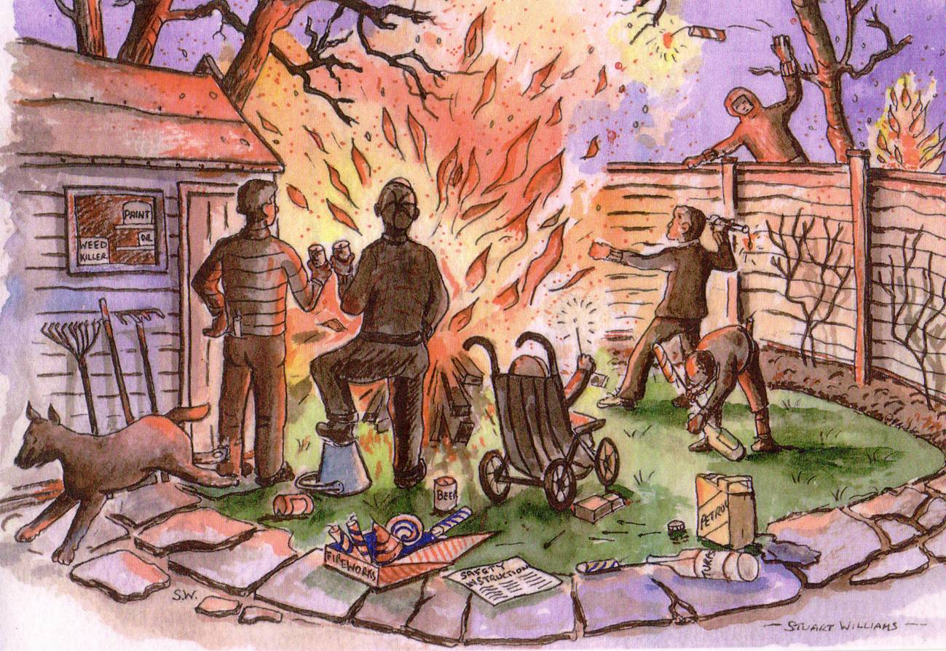
What is wrong with this bonfire scene?
Notes:
What's wrong in this picture?
Throwing fireworks over fence.
Bonfire too near fence and building.
Building has flammable items inside.
Pets not kept indoors.
Very young child in pram with sparkler.
Flammable liquids (petrol) spilt on floor.
Fireworks not in their closed box.
Fire near trees/overhead cables.
Firework safety instructions not being read.
Rocket being fired from turps bottle.
Empty bucket on floor – should have water in it in case needed.
Adults drinking alcohol near to fire.
Using matches to ignite fireworks – always use the supplied stick.

Slide 14
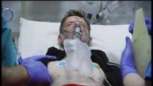
The reality of the dangers of Bonfire night
Notes:
Explain to children this is a dramatised version!
Teenager Keegan Morton, from Birkenhead, suffered burns to his face when an aerosol can thrown onto a fire exploded.​
Keegan Morton, 14, from Birkenhead, was kept alive by a ventilator after the shocking accident, which nearly cost him his sight.​
Keegan previously spoke of how his “face felt like it was on fire” during what his mum described as “the worst night of my life”.​
Keegan and a friend were throwing objects onto a bonfire in Edgemore Close, Birkenhead, two years ago when the canister exploded.​
Keegan was rushed to Arrowe Park Hospital and later transferred to Alder Hey.
Keegan and his mum are now supporting Merseyside Fire brigade in their promotion of safety on bonfire night.

Slide 15
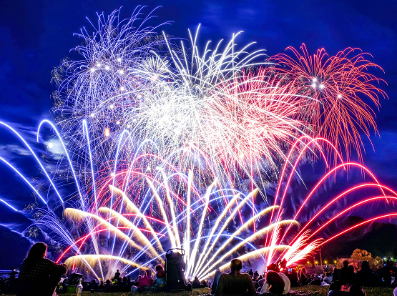
Final points to remember…
Look out for the organised events taking place in your area
If you witness antisocial behaviour, please report it to via our website, or instant messaging @merpolCC, or by calling 101. In an emergency dial 999.
Allow the Emergency and Public Services to do their job safely
HAVE A SAFE, ENJOYABLE AND HAPPY HALLOWEEN AND BONFIRE NIGHT!
Notes:
Promote key points:
Organised events will be listed on the PCC website
Bonfire Safety, Correct use of Fireworks, ASB and Attacks on emergency services will not be tolerated, hate crimes are wrong and severely punished.
Emphasise to stay safe, stay smart, and stay onside.
There will be extra policing patrols to deter anti-social behaviour and criminal activity and provide extra reassurance in our communities
We’ll have increased patrols out and about for support and guidance for our communities who want to enjoy the period safely, and won’t hesitate to take action against anyone engaging in dangerous or anti-social behaviour.
Merseyside police also work with Merseyside Fire and Rescue Service will also be patrolling local areas to ensure the safety of any planned events and removing any potential fire risks or hazards
There will be local planned activities for young people that you can attend

